Slide 1
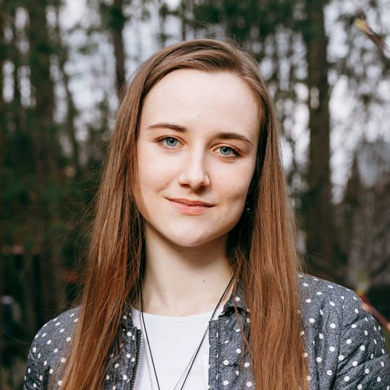
Varvara
Lazarenko
Address
Telephone
E-mail
Date of birth
LinkedIn
Nijmegen, The Netherlands
+31 6 2662 9839
varlazoa@gmail.com
29.12.1998 (26 years)
www.linkedin.com/in/varvara-lazo
PERSONAL STATEMENT
I am a curious and dedicated graduate with a Master’s degree in Medical Biology, driven by a passion for advancing healthcare through science. My experience spans both fundamental research and clinical trial development. With a solid biomedical background and a keen interest in sharing knowledge, I am motivated to learn new research methods and to grow within the clinical, pharmaceutical, or academic field.
EDUCATION
09/2022 – 08/2024
MSc in Medical Biology – Radboud University, Nijmegen, The Netherlands
Specialisation: Science, Management and Innovation
GPA result: 7.63/10.00
Principal subjects: Future of health, How Health Systems Work, Sustainable Innovation Management, Molecular and Cellular Neurobiology, Molecular Therapy, Trends in Stem Cell Biology
Master thesis: «Potential added value of home telemonitoring technology in elderly care», GPA result: 8.00/10.00
BSc in Biology – Lomonosov Moscow State University (MSU), Moscow, Russia
Specialisation: Human and Animal Physiology
GPA result: 4.83/5.00
Principal subjects: Human and animal physiology, Electrophysiology of excited cells, Physiology of central nervous and visceral systems, Physiology of circulation, Embryology, Genetics, Microbiology, Biochemistry, Immunology
Skills: PCR, qPCR, RT-PCR, gel electrophoresis, wire myography, western blotting, ELISA, microscopy, cell culture, immunohistochemistry, intracellular recording (microelectrodes, patch clamp), behaviour tests (open field test, elevated plus maze, light-dark box test)
Bachelor thesis: «Role of TASK-1 channels in arterial tone regulation in different organs in rats», GPA result: 5.00/5.00
09/2016 – 06/2020
WORK EXPERIENCE
10/2024 – current
Part-time staff while searching for a life sciences position
Renato’s Pizzeria – Nijmegen, The Netherlands
Providing customer service
Selling the restaurant’s menu
Intern at Digital Transformation of Rehabilitation Care
HAN University of Applied Sciences – Nijmegen, The Netherlands
Added value research of home telemonitoring in elderly care based on the HTA framework presented onto the Quadruple aim
Deployment of surveys (22) in Dutch and interviewing (7) medical professionals in English on their home telemonitoring experience/attitude
Cost-effectiveness analysis (Markov model cohort simulation) on home telemonitoring in the Netherlands
Intern at Neuronal Networks of Memory
Donders Institute – Nijmegen, The Netherlands
In vivo Ca²⁺ imaging of the retrosplenial cortex in mice during head-fixed virtual social learning using two-photon microscopy
Management of laboratory animals (GCaMP6 transgenic mice, handling & feeding, craniotomy)
Computational analysis of the obtained data (Python, DeepLabCut)
02/2024 – 08/2024
02/2023 – 08/2023

Slide 2
08/2021 – 08/2022
Assistant at the Science Department of the Contract Research Organization
LABMGMU, LLC – Moscow, Russia
Developing designs, synopses, protocols, investigator’s brochures for >35 phase I, II, III clinical trials and bioequivalence trials
>30 user interviews (testing the readability of pharmaceuticals’ package leaflets)
Advising on the number & design of (pre-)clinical studies for pharma clients
Project management (control of the deadlines; compliance with the sponsor’s requirements)
Computational analysis of the obtained data (STATISTICA, GraphPad Prism)
10/2020 – 10/2021
Junior Research Assistant at Faculty of Biology
Lomonosov Moscow State University – Moscow, Russia
Physiological (wire myography technique, rat coronary and renal arteries) and molecular (RNA extraction, reverse transcription, qPCR) experiments
Management of laboratory animals (Wistar rats: housing, care, breeding)
Statistical analysis of the obtained data (STATISTICA, GraphPad Prism)
Project management (experiment and research strategy planning)
Presentation of the results at the virtual conference ARTERY20, 23-24 October 2020, and at the 28th International Scientific Conference “Lomonosov-2021”, 12-23 April 2021
SCIENTIFIC JOURNAL PUBLICATIONS
Shvetsova Anastasia A., Lazarenko Varvara S., Gaynullina Dina K., Tarasova Olga S., Schubert Rudolf (2022). TWIK-Related Acid-Sensitive Potassium Channels (TASK-1) Emerge as Contributors to Tone Regulation in Renal Arteries at Alkaline pH. Frontiers in physiology, 13: 895863. https://doi.org/10.3389/fphys.2022.895863
2. Lazarenko Varvara, Shvetsova Anastasia, Gaynullina Dina, Schubert Rudolph (2020). TASK-1 Channels Play an Anticontractile Role in Rat Septal Coronary Artery Under Pharmacological Blockade of Endothelium. Artery Research, 26(S1): S58. https://doi.org/10.2991/artres.k.201209.048
3. Borzykh A.A., Kuzmin I.V., Kiryukhina O.O., Selivanova E.K., Shvetsova A.A., Lazarenko V.S., Los-Arkos Uvarova S., Nesterenko A.M., Tarasova O.S. (2020). Voluntary running training of female rats during gestation: characteristics of an experimental model [in Russian]. Aviakosmicheskaya i Ekologicheskaya Meditsina, 54(2): 89–95. https://www.elibrary.ru/item.asp?id=42721639
2023
2021
CERTIFICATES
A FELASA accredited course on Laboratory Animal Science (EU function B) at Radboudumc
An upgrade training on ICH guidelines on Good Clinical Practice (GCP) at LABMGMU
ACADEMIC HONORS AND AWARDS
2022-2024
2020-2021
2021
Awarded Orange Tulip Scholarship for the studies at Radboud University
Awarded MSU Increased State Academic Scholarship for scientific and academic achievements
Second prize-winner in the Lomonosov Universiade on modern problems of biology
DIGITAL SKILLS
Python (beginner), DeepLabCut, STATISTICA, GraphPad Prism, Rotor-Gene Q Series, and MS Office softwares
LANGUAGES
Russian (native), English (fluent – С₂), German (intermediate – B₁-В₂), Dutch (low intermediate – А₂-В₁), French (beginner - A₁)
VOLUNTEERING ACTIVITY
2024
2023
2022-2023
2018-2021
Mentorship of the international exchange and Master’s students at the Radboud Intro
Organization of the BBB Career Event 2023, Nijmegen
Organization of volleyball tournaments in the international volleyball group at Radboud
Mentorship of the first-year students at Faculty of Biology, MSU, Moscow
HOBBIES
Animals (horses & dogs), volleyball, reading, drawing, guitar playing, traveling

